Slide 1
Module 5: Networking and Content Delivery
AWS Academy Cloud Foundations
© 2019, Amazon Web Services, Inc. or its Affiliates. All rights reserved.
Notes:
Today we are going to start with a new module Networking and Content Delivery
This module covers three fundamental Amazon Web Services (AWS) for networking and content delivery: Amazon Virtual Private Cloud (Amazon VPC), Amazon Route 53, and Amazon CloudFront.
Amazon Virtual Private Cloud (Amazon VPC) gives you full control over your virtual networking environment, including resource placement, connectivity, and security. Get started by setting up your VPC in the AWS service console. Next, add resources to it such as Amazon Elastic Compute Cloud (EC2) and Amazon Relational Database Service (RDS) instances. Finally, define how your VPCs communicate with each other across accounts, Availability Zones, or AWS Regions. We will also see In the examples, how network traffic is being shared between two VPCs within each Region.
Amazon Route 53 is a highly available and scalable cloud Domain Name System (DNS) web service. It is designed to give developers and businesses an extremely reliable and cost effective way to route end users to Internet applications by translating names like www.google.com into the numeric IP addresses like 142.250.183.110 that computers use to connect to each other.
Amazon CloudFront is a fast content delivery network (CDN) service that securely delivers data, videos, applications, and APIs to customers globally with low latency, high transfer speeds, all within a developer-friendly environment. CloudFront has Edge locations in various places in and around that region . These Edge locations are connected by private network directly to Amazon Web Services Region CloudFront works seamlessly with services, including Amazon Shield Standard for DDoS mitigation, and Amazon S3, Elastic Load Balancing, or Amazon EC2 as origins for your applications. You can get started with the Content Delivery Network in minutes, using the Amazon Web Services tools that you're already familiar with: APIs, Amazon Web Services Management Console, Command Line Interface (CLI), and SDKs. Amazon's CDN offers a simple, pay-as-you-go pricing model with no upfront fees or required long-term contracts, and support for the CDN is included in your existing Amazon Support subscription.

Slide 2
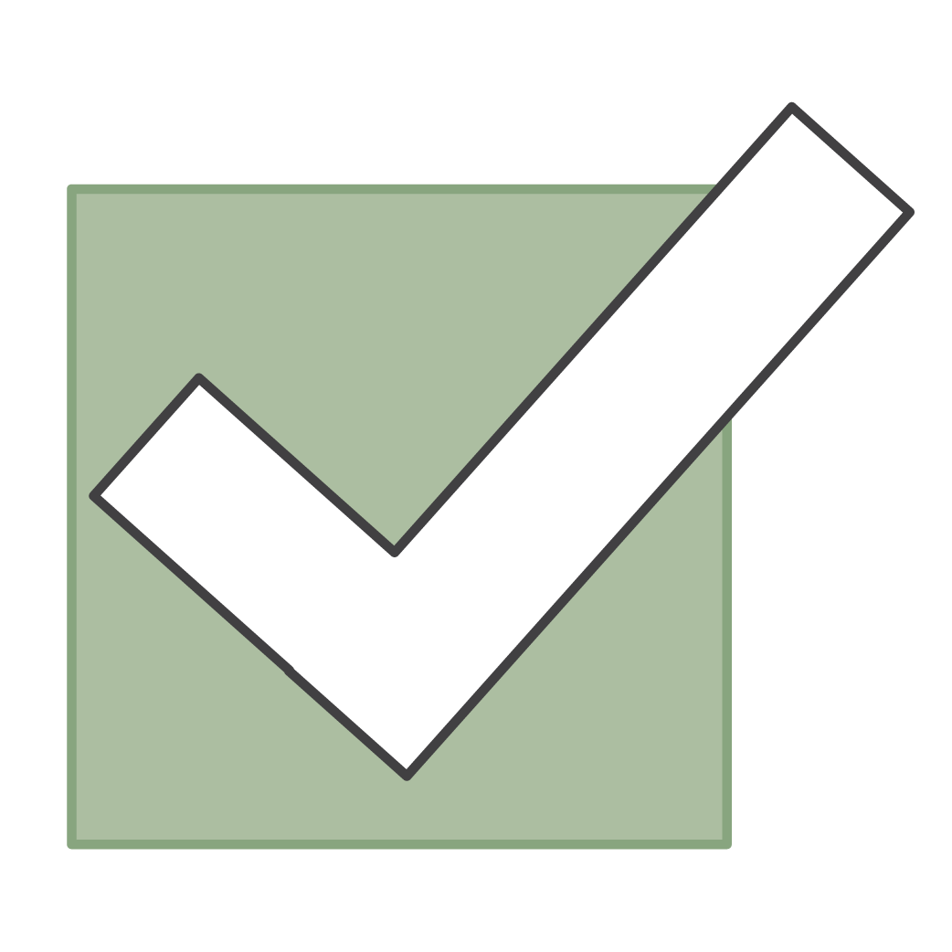
Module overview
Topics
Networking basics
Amazon VPC
VPC networking
VPC security
Amazon Route 53
Amazon CloudFront
Activities
Label a network diagram
Design a basic VPC architecture
Demo
VPC demonstration
Lab
Build your VPC and launch a web server
Knowledge check
Notes:
In This module we will be addressing the following topics:
Networking basics
Amazon Virtual Private Cloud (Amazon VPC)
VPC networking
VPC security
Amazon Route 53
Amazon CloudFront
This module includes some activities that challenge you to label a network diagram and design a basic VPC architecture.
You will watch a demonstration to learn how to use the VPC Wizard to create a VPC with public and private subnets.
You then get a chance to apply what you have learned in a hands-on lab where you use the VPC Wizard to build a VPC and launch a web server.
Finally, you will be asked to complete a knowledge check that test your understanding of key concepts that are covered in this module.

Slide 3
Module objectives
After completing this module, you should be able to:
Recognize the basics of networking
Describe virtual networking in the cloud with Amazon VPC
Label a network diagram
Design a basic VPC architecture
Indicate the steps to build a VPC
Identify security groups
Create your own VPC and add additional components to it to produce a customized network
Identify the fundamentals of Amazon Route 53
Recognize the benefits of Amazon CloudFront
Notes:
So what is the objective of this module. After completing this module, you should be able to:
Recognize the basics of networking
Describe virtual networking in the cloud with Amazon VPC
Label a network diagram
Design a basic VPC architecture
Indicate the steps to build a VPC
Identify security groups
Create your own VPC and add additional components to it to produce a customized network
Identify the fundamentals of Amazon Route 53
Recognize the benefits of Amazon CloudFront

Slide 4
Section 1: Networking basics
Module 5: Networking and Content Delivery
Notes:
In this section we will be discussing Networking basics. So what is the Network? In very simple term -
A computer network is a group of computers linked to each other that enables the computer to communicate with another computer and share their resources, data, and applications.
Computer Networks are built using a collection of hardware (such as routers, switches, hubs, and so forth) and networking software (such as operating systems, firewalls, or corporate applications).
In this section, we will review a few basic networking concepts that provide the necessary foundation to your understanding of the AWS networking service, Amazon VPC
What we do in AWS cloud? We deploy applications properly known as Web Applications or in short web app. These web apps uses some resources. Theses resources are composed of AWS components known as services or hardware's. We need to understand how to connect those services to each other. For this, AWS offers the networking services. Like everything , networking is a large and complicated subject. We'll be going over the details of how networking works to give you a quick high level understanding of the tools that AWS offers.
First and most important of the networking tools is your VPC. This is how you'll connect together your EC2 instances, EBS volumes, RDS databases, elastic load balancers, and more to create a fully functioning web app. In an on premise setup, your networks would be created by literally wiring up your servers to each other, but on the Cloud, we have to do it all virtually. To do this, you create a private Cloud in VPC. This private Cloud will house all of your instances, volumes, and more. With VPC, you can create subnetworks, i.e., smaller networks with rules on how they can connect to each other. A common use case is to have two subnets, one public facing and one private. You put your front end code on EC2 instances in the public facing subnet and then users on the internet can connect to your website. You then put your back-end code and your databases and volumes and more on the private subnet. This way, users can only connect to your data through your front-end servers, giving malicious actors fewer ways to attack your system and data. Architecting these sorts of network solutions will make your app more secure.
EX: diagram of a vpc with public and private subnets

Slide 5
Networks
Number System
Protocol
IP Addressing
Notes:
Before going into VPC and its components, we must understand the basic building blocks of Network. What is the theory, what are the different terms used in networking, what are the different components,, what is their functionality and uses. Let us compare this with a example of construction of buildings. There is an engineer who is engaged in a construction of a building……………
We will try to understand
Number System
Protocol
Different Components
IP Addressing

Slide 6
Networks
Number System :-
Decimal
Roman
Binary
Octal
HexaDecimal
Notes:
What is a number system
A numeral system (or system of numeration) is a writing system for expressing numbers; that is, a mathematical notation for representing numbers of a given set, using digits or other symbols in a consistent manner. There are various number system in use. Some popular ones are
Decimal
Roman
Binary
Octal
HexaDecimal
And many more. Any number system has fix number of symbols known as digits. For example the most popular is Decimal Number system where we use 10 symbols which are 0, 1, 2, 3, 9 With help of these symbols or digits we perform mathematical operations like counting, addition, subtraction etc.
Let us concentrate on one operation the very basic one i.e. counting. So how counting works let us see with examples
https://www.cuemath.com/numbers/number-systems/

Slide 7
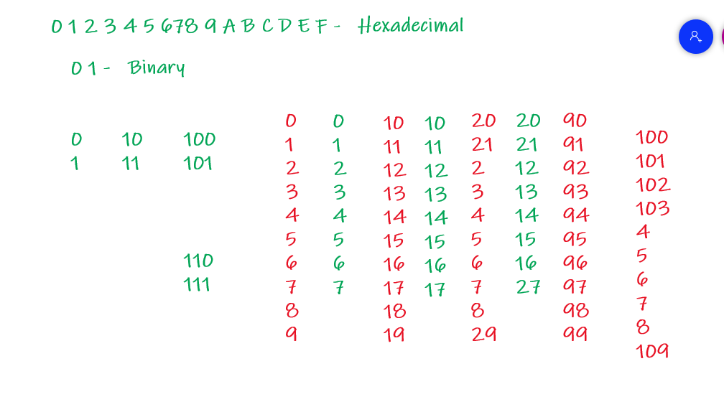
Networks

Slide 8
Networks
Conversion of Number from one number system to another
Decimal to Binary
Binary to Decimal
Notes:
In Previous slide we have seen how counting works in any number system. I.e. there are some symbols places in a specified order and follows a pattern for counting operation. Now how you can convert a number written in one number system to another number system.
Let us convert Decimal number into binary number
And Binary to Decimal

Slide 9
Networks
Protocol
Network protocols:
•TCP/IP - DOD
•IPx/SPx - Novell
•AppleTalk - Apple
•NetBIOS - Microsoft
•OSI – ISO
Notes:
A network protocol defines rules and conventions for communication between network devices. Network protocols include mechanisms for devices to identify and make connections with each other, as well as formatting rules that specify how data is packaged into sent
Some of popular protocols :-
Network protocols:
•TCP/IP - DOD Dept of Defence USA
•IPx/SPx - Novell
•AppleTalk - Apple
•NetBIOS - Microsoft
•OSI – ISO
To understand these computer network protocols we need to understand what is protocol , So in general protocol is a set of rule or procedure that all follow for smooth running of any system.
WHAT IS TCP/IP
The TCP/IP Internet protocols, a common example, consist of: Transmission Control Protocol (TCP), which uses a set of rules to exchange messages with other Internet points at the information packet level.Internet Protocol (IP), which uses a set of rules to send and receive messages at
Transmission Control Protocol/Internet Protocol (TCP/IP) is the language a computer uses to access the internet. It consists of a suite of protocols designed to establish a network of networks
TCP/IP is responsible for full-fledged data connectivity and transmitting the data end to end by providing other functions, including addressing, mapping and acknowledgment
The technology is so common that one would rarely use the full name. In other words, in common
TCP/IP is a standard protocol used between computers and network devices for communication.
TCP/IP addressing:
•IP Address is logical address given to each and every device in the network.
•It is a Network layer address(Layer 3)
•Two versions of IP:
IP Version 4
IP Version 6

Slide 10
IP addresses
192
.
0
.
2
.
0
11000000
00000000
00000010
00000000
Notes:
Each client machine in a network has a unique Internet Protocol (IP) address that identifies it. An IP address is a numerical label in decimal format. Machines convert that decimal number to a binary format.
In this example, the IP address is 192.0.2.0. Each of the four dot (.)-separated numbers of the IP address represents 8 bits in octal number format. That means each of the four numbers can be anything from 0 to 255. The combined total of the four numbers for an IP address is 32 bits in binary format.
IPV4 ADDRESS
Bit is represented by 0 or 1.
IP address in binary form (32 bit).
32 bits are divided into 4 Octets:
11000000 00000000 00000010 00000000
First Octet Second Octet Third Octet Fourth Octet
IP Address in decimal form:
192.0.2.0
https://www.pcmag.com/encyclopedia/term/ip-address

Slide 11
IP addresses
Range of IP Address
RANGE OF IPv4 ADDRESS
Taking example as all 0’s and all 1’s
0 0 0 0 0 0 0 0 = 0
0 0 0 0 0 0 0 1 = 1
0 0 0 0 0 0 1 0 = 2
0 0 0 0 0 0 1 1 = 3
0 0 0 0 0 1 0 0 = 4
1 1 1 1 1 1 1 1 = 255
Total IP Address Range: 0.0.0.0 to 255.255.255.255

Slide 12
IPv4 and IPv6 addresses
IPv4 (32-bit) address: 192.0.2.0
IPv6 (128-bit) address: 2600:1f18:22ba:8c00:ba86:a05e:a5ba:00FF
Notes:
A 32-bit IP address is called an IPv4 address.
IPv6 addresses, which are 128 bits, are also available. IPv6 addresses can accommodate more user devices.
An IPv6 address is composed of eight groups of four letters and numbers that are separated by colons (:). In this example, the IPv6 address is 2600:1f18:22ba:8c00:ba86:a05e:a5ba:00FF. Each of the eight colon-separated groups of the IPv6 address represents 16 bits in hexadecimal number format. That means each of the eight groups can be anything from 0 to FFFF. The combined total of the eight groups for an IPv6 address is 128 bits in binary format.

Slide 13
IP Address Classification
IP ADDRESS CLASSIFICATION
IP ADDRESS are divided into 5 classes
CLASS A 0 - 127
CLASS B 128 - 191
CLASS C 192 - 223
CLASS D 224 – 239
CLASS E 240 – 255
CLAS A, B, C used in LAN & WAN
CLASS D reserved for multicasting
CLASS E reserved for research & development and for future use
Notes:
In the IPv4 IP address space, there are five classes: A, B, C, D and E. Each class has a specific range of IP addresses (and ultimately dictates the number of devices you can have on your network). Primarily, class A, B, and C are used by the majority of devices on the Internet. Class D and class E are for special uses.
The list below shows the five available IP classes, along with the number of networks each can support and the maximum number of hosts (devices) that can be on each of those networks. The four octets that make up an IP address are conventionally represented by a.b.c.d - such as 127.10.20.30.
https://docs.oracle.com/cd/E19504-01/802-5753/planning3-78185/index.html

Slide 14
Public IP address And Private IP Address
Public IP Address
External (global) reach
Used for communicating outside your private network, over the internet
A unique numeric code never reused by other devices
Found by Googling: "What is my IP address?“
Assigned and controlled by your internet service provider
Not free
Private IP Address
Internal (local) reach
Used for communicating within your private network, with other devices in your home or office
A non-unique numeric code that may be reused by other devices in other private networks
Found via your device’s internal settings
Assigned to your specific device within a private network
Notes:
What is a public IP address?
A public IP address is an IP address that can be accessed directly over the internet and is assigned to your network router by your internet service provider (ISP). Your personal device also has a private IP that remains hidden when you connect to the internet through your router’s public IP.
Using a public IP address to connect to the internet is like using a P.O. box for your snail mail, rather than giving out your home address. It’s a little bit safer, but a lot more visible.
What is a private IP address?
A private IP address is the address your network router assigns to your device. Each device within the same network is assigned a unique private IP address (sometimes called a private network address) — this is how devices on the same internal network talk to each other.
Private IP addresses let devices connected to the same network communicate with one another without connecting to the entire internet. By making it more difficult for an external host or user to establish a connection, private IPs help bolster security within a specific network, like in your home or office. This is why you can print documents via wireless connection to your printer at home, but your neighbor can’t send their files to your printer accidentally.
https://byjus.com/gate/difference-between-private-and-public-ip-addresses/

Slide 15
Public IP address types
Public IPv4 address
Manually assigned through an Elastic IP address
Automatically assigned through the auto-assign public IP address settings at the subnet level
Elastic IP address
Associated with an AWS account
Can be allocated and remapped anytime
Additional costs might apply
Notes:
When you create a VPC, every instance in that VPC gets a private IP address automatically. You can also request a public IP address to be assigned when you create the instance by modifying the subnet’s auto-assign public IP address properties.
An Elastic IP address is a static and public IPv4 address that is designed for dynamic cloud computing. You can associate an Elastic IP address with any instance or network interface for any VPC in your account. With an Elastic IP address, you can mask the failure of an instance by rapidly remapping the address to another instance in your VPC. Associating the Elastic IP address with the network interface has an advantage over associating it directly with the instance. You can move all of the attributes of the network interface from one instance to another in a single step.
Additional costs might apply when you use Elastic IP addresses, so it is important to release them when you no longer need them.
To learn more about Elastic IP addresses, see Elastic IP Addresses in the AWS Documentation.

Slide 16
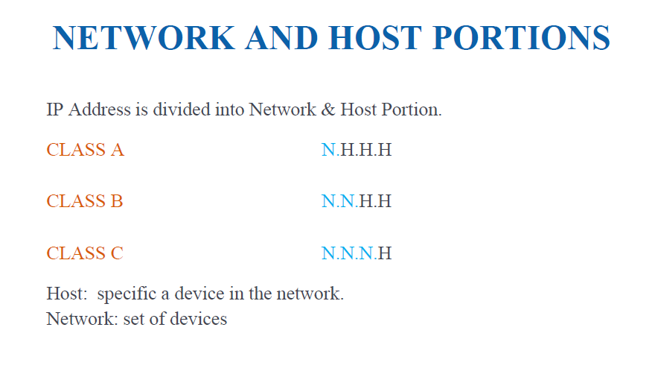
Private IP address Class

Slide 17
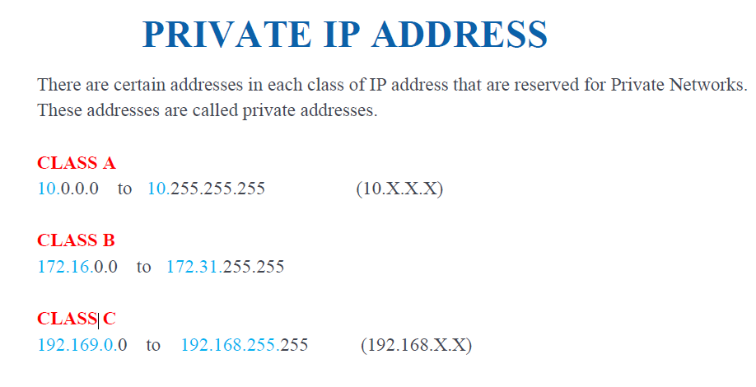
Private IP address Class

Slide 18
Classless Inter-Domain Routing (CIDR)
Network identifier (routing prefix)
Host identifier
192
.
0
.
2
.
0
/
24
Tells you how many bits are fixed
11000000
00000000
00000010
00000000 to 11111111
Fixed
Fixed
Fixed
Flexible
Notes:
A common method to describe networks is Classless Inter-Domain Routing (CIDR). The CIDR address is expressed as follows:
An IP address (which is the first address of the network)
Next, a slash character (/)
Finally, a number that tells you how many bits of the routing prefix must be fixed or allocated for the network identifier
The bits that are not fixed are allowed to change. CIDR is a way to express a group of IP addresses that are consecutive to each other.
In this example, the CIDR address is 192.0.2.0/24. The last number (24) tells you that the first 24 bits must be fixed. The last 8 bits are flexible, which means that 2⁸ (or 256) IP addresses are available for the network, which range from 192.0.2.0 to 192.0.2.255. The fourth decimal digit is allowed to change from 0 to 255.
If the CIDR was 192.0.2.0/16, the last number (16) tells you that the first 16 bits must be fixed. The last 16 bits are flexible, which means that 2¹⁶ (or 65,536) IP addresses are available for the network, ranging from 192.0.0.0 to 192.0.255.255. The third and fourth decimal digits can each change from 0 to 255.
There are two special cases:
Fixed IP addresses, in which every bit is fixed, represent a single IP address (for example, 192.0.2.0/32). This type of address is helpful when you want to set up a firewall rule and give access to a specific host.
The internet, in which every bit is flexible, is represented as 0.0.0.0/0
https://www.educba.com/what-is-cidr/

Slide 19

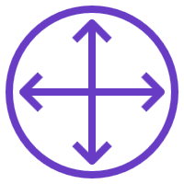
Networks
Subnet 1
Subnet 2
Router
Notes:
A computer network is two or more client machines that are connected together to share resources. A network can be logically partitioned into subnets. Networking requires a networking device (such as a router or switch) to connect all the clients together and enable communication between them.

Slide 20
Open Systems Interconnection (OSI) model
Layer | Number | Function | Protocol/Address
Application | 7 | Means for an application to access a computer network | HTTP(S), FTP, DHCP, LDAP
Presentation | 6 | Ensures that the application layer can read the data Encryption | ASCI, ICA
Session | 5 | Enables orderly exchange of data | NetBIOS, RPC
Transport | 4 | Provides protocols to support host-to-host communication | TCP, UDP
Network | 3 | Routing and packet forwarding (routers) | IP
Data link | 2 | Transfer data in the same LAN network (hubs and switches) | MAC
Physical | 1 | Transmission and reception of raw bitstreams over a physical medium | Signals (1s and 0s)
Notes:
The Open Systems Interconnection (OSI) model is a conceptual model that is used to explain how data travels over a network. It consists of seven layers and shows the common protocols and addresses that are used to send data at each layer. For example, hubs and switches work at layer 2 (the data link layer). Routers work at layer 3 (the network layer). The OSI model can also be used to understand how communication takes place in a virtual private cloud (VPC), which you will learn about in the next section.
https://www.cloudflare.com/en-in/learning/ddos/glossary/open-systems-interconnection-model-osi/

Slide 21
Section 2: Amazon VPC
Module 5: Networking and Content Delivery
Notes:
Section 2: Amazon VPC
Many of the concepts of an on-premises network apply to a cloud-based network, but much of the complexity of setting up a network has been abstracted without sacrificing control, security, and usability. In this section, you learn about Amazon VPC and the fundamental components of a VPC.

Slide 22
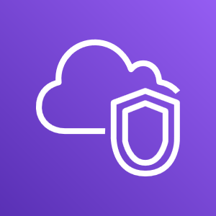
Amazon VPC
Enables you to provision a logically isolated section of the AWS Cloud where you can launch AWS resources in a virtual network that you define
Gives you control over your virtual networking resources, including:
Selection of IP address range
Creation of subnets
Configuration of route tables and network gateways
Enables you to customize the network configuration for your VPC
Enables you to use multiple layers of security
Amazon VPC
Notes:
Amazon Virtual Private Cloud (Amazon VPC) is a service that lets you provision a logically isolated section of the AWS Cloud (called a virtual private cloud, or VPC) where you can launch your AWS resources.
Amazon VPC gives you control over your virtual networking resources, including the selection of your own IP address range, the creation of subnets, and the configuration of route tables and network gateways. You can use both IPv4 and IPv6 in your VPC for secure access to resources and applications.
You can also customize the network configuration for your VPC. For example, you can create a public subnet for your web servers that can access the public internet. You can place your backend systems (such as databases or application servers) in a private subnet with no public internet access.
Finally, you can use multiple layers of security, including security groups and network access control lists (network ACLs), to help control access to Amazon Elastic Compute Cloud (Amazon EC2) instances in each subnet.
https://aws.amazon.com/vpc/

Slide 23
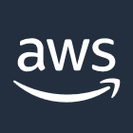

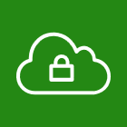

VPCs and subnets
VPCs:
Logically isolated from other VPCs
Dedicated to your AWS account
Belong to a single AWS Region and can span multiple Availability Zones
Subnets:
Range of IP addresses that divide a VPC
Belong to a single Availability Zone
Classified as public or private
AWS Cloud
Region
Availability Zone 1
Availability Zone 2
VPC
Subnet
Subnet
Notes:
A subnet is a range of IP addresses in your VPC. You can launch AWS resources, such as EC2 instances, into a specific subnet. When you create a subnet, you specify the IPv4 CIDR block for the subnet, which is a subset of the VPC CIDR block. Each subnet must reside entirely within one Availability Zone and cannot span zones. By launching instances in separate Availability Zones, you can protect your applications from the failure of a single zone.
Amazon VPC enables you to provision virtual private clouds (VPCs). A VPC is a virtual network that is logically isolated from other virtual networks in the AWS Cloud. A VPC is dedicated to your account. VPCs belong to a single AWS Region and can span multiple Availability Zones.
After you create a VPC, you can divide it into one or more subnets. A subnet is a range of IP addresses in a VPC. Subnets belong to a single Availability Zone. You can create subnets in different Availability Zones for high availability. Subnets are generally classified as public or private. Public subnets have direct access to the internet, but private subnets do not.

Slide 24
IP addressing
When you create a VPC, you assign it to an IPv4 CIDR block (range of private IPv4 addresses).
You cannot change the address range after you create the VPC.
The largest IPv4 CIDR block size is /16.
The smallest IPv4 CIDR block size is /28.
IPv6 is also supported (with a different block size limit).
CIDR blocks of subnets cannot overlap.
VPC
x.x.x.x/16 or 65,536 addresses (max)
to x.x.x.x/28 or 16 addresses (min)
Notes:
IP addresses enable resources in your VPC to communicate with each other and with resources over the internet. When you create a VPC, you assign an IPv4 CIDR block (a range of private IPv4 addresses) to it. After you create a VPC, you cannot change the address range, so it is important that you choose it carefully. The IPv4 CIDR block might be as large as /16 (which is 2¹⁶, or 65,536 addresses) or as small as /28 (which is 2⁴, or 16 addresses).
You can optionally associate an IPv6 CIDR block with your VPC and subnets, and assign IPv6 addresses from that block to the resources in your VPC. IPv6 CIDR blocks have a different block size limit.
The CIDR block of a subnet can be the same as the CIDR block for a VPC. In this case, the VPC and the subnet are the same size (a single subnet in the VPC). Also, the CIDR block of a subnet can be a subset of the CIDR block for the VPC. This structure enables the definition of multiple subnets. If you create more than one subnet in a VPC, the CIDR blocks of the subnets cannot overlap. You cannot have duplicate IP addresses in the same VPC.
To learn more about IP addressing in a VPC, see the AWS Documentation.

Slide 25
Reserved IP addresses
Example: A VPC with an IPv4 CIDR block of 10.0.0.0/16 has 65,536 total IP addresses. The VPC has four equal-sized subnets. Only 251 IP addresses are available for use by each subnet.
IP Addresses for CIDR block 10.0.0.0/24 | Reserved for
10.0.0.0 | Network address
10.0.0.1 | Internal communication
10.0.0.2 | Domain Name System (DNS) resolution
10.0.0.3 | Future use
10.0.0.255 | Network broadcast address
VPC: 10.0.0.0/16
Subnet 1 (10.0.0.0/24)
Subnet 2 (10.0.2.0/24)
251 IP addresses
251 IP addresses
Subnet 4 (10.0.1.0/24)
Subnet 3 (10.0.3.0/24)
251 IP addresses
251 IP addresses
Notes:
When you create a subnet, it requires its own CIDR block. For each CIDR block that you specify, AWS reserves five IP addresses within that block, and these addresses are not available for use. AWS reserves these IP addresses for:
Network address
VPC local router (internal communications)
Domain Name System (DNS) resolution
Future use
Network broadcast address
For example, suppose that you create a subnet with an IPv4 CIDR block of 10.0.0.0/24 (which has 256 total IP addresses). The subnet has 256 IP addresses, but only 251 are available because five are reserved.
0.0: Network address.
0.1: Reserved by AWS for the VPC router.
0.2: Reserved by AWS. The IP address of the DNS server is the base of the VPC network range plus two. ...
0.3: Reserved by AWS for future use.
0.255: Network broadcast address.

Slide 26
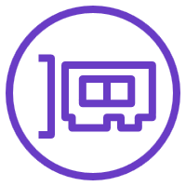
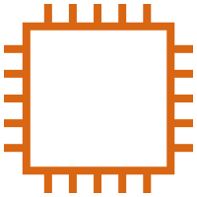
Elastic network interface
An elastic network interface is a virtual network interface that you can:
Attach to an instance.
Detach from the instance, and attach to another instance to redirect network traffic.
Its attributes follow when it is reattached to a new instance.
Each instance in your VPC has a default network interface that is assigned a private IPv4 address from the IPv4 address range of your VPC.
Subnet: 10.0.1.0/24
Elastic network interface
Notes:
An elastic network interface is a virtual network interface that you can attach or detach from an instance in a VPC. A network interface's attributes follow it when it is reattached to another instance. When you move a network interface from one instance to another, network traffic is redirected to the new instance.
Each instance in your VPC has a default network interface (the primary network interface) that is assigned a private IPv4 address from the IPv4 address range of your VPC. You cannot detach a primary network interface from an instance. You can create and attach an additional network interface to any instance in your VPC. The number of network interfaces you can attach varies by instance type.
For more information about Elastic Network Interfaces, see the AWS Documentation.

Slide 27
Route tables and routes
A route table contains a set of rules (or routes) that you can configure to direct network traffic from your subnet.
Each route specifies a destination and a target.
By default, every route table contains a local route for communication within the VPC.
Each subnet must be associated with a route table (at most one).
Main (Default) Route Table
Destination | Target
10.0.0.0/16 | local
VPC CIDR block
Notes:
A route table contains a set of rules (called routes) that directs network traffic from your subnet. Each route specifies a destination and a target. The destination is the destination CIDR block where you want traffic from your subnet to go. The target is the target that the destination traffic is sent through. By default, every route table that you create contains a local route for communication in the VPC. You can customize route tables by adding routes. You cannot delete the local route entry that is used for internal communications.
Each subnet in your VPC must be associated with a route table. The main route table is the route table is automatically assigned to your VPC. It controls the routing for all subnets that are not explicitly associated with any other route table. A subnet can be associated with only one route table at a time, but you can associate multiple subnets with the same route table.
To learn more about route tables, see the AWS Documentation.

Slide 28

Section 2 key takeaways
A VPC is a logically isolated section of the AWS Cloud.
A VPC belongs to one Region and requires a CIDR block.
A VPC is subdivided into subnets.
A subnet belongs to one Availability Zone and requires a CIDR block.
Route tables control traffic for a subnet.
Route tables have a built-in local route.
You add additional routes to the table.
The local route cannot be deleted.
Notes:
Some key takeaways from this section of the module include:
A VPC is a logically isolated section of the AWS Cloud.
A VPC belongs to one Region and requires a CIDR block.
A VPC is subdivided into subnets.
A subnet belongs to one Availability Zone and requires a CIDR block.
Route tables control traffic for a subnet.
Route tables have a built-in local route.
You add additional routes to the table.
The local route cannot be deleted.

Slide 29
Section 3: VPC networking
Module 5: Networking and Content Delivery
Notes:
Section 3: VPC networking
Now that you have learned about the basic components of a VPC, you can start routing traffic in interesting ways. In this section, you learn about different networking options.

Slide 30
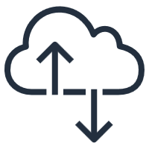
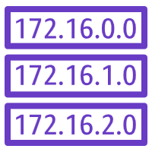
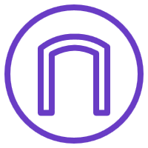

Internet gateway
AWS Cloud
Region
Availability Zone
VPC: 10.0.0.0/16
Public subnet:10.0.1.0/24
Public Subnet Route Table
Destination | Target
10.0.0.0/16 | local
0.0.0.0/0 | igw-id
Private subnet: 10.0.2.0/24
Route table
Internet gateway
(igw-id)
Internet
Notes:
An internet gateway is a scalable, redundant, and highly available VPC component that allows communication between instances in your VPC and the internet. An internet gateway serves two purposes: to provide a target in your VPC route tables for internet-routable traffic, and to perform network address translation for instances that were assigned public IPv4 addresses.
To make a subnet public, you attach an internet gateway to your VPC and add a route to the route table to send non-local traffic through the internet gateway to the internet (0.0.0.0/0).
For more information about internet gateways, see Internet Gateways in the AWS Documentation.
https://docs.aws.amazon.com/vpc/latest/userguide/VPC_Internet_Gateway.html

Slide 31
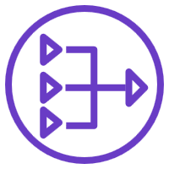
Network address translation (NAT) gateway
AWS Cloud
Region
Availability Zone
VPC: 10.0.0.0/16
Public subnet:10.0.1.0/24
Public Subnet Route Table
Public route table
Destination | Target
10.0.0.0/16 | local
0.0.0.0/0 | igw-id
NAT gateway (nat-gw-id)
Private subnet: 10.0.2.0/24
Internet gateway
(igw-id)
Private route table
Private Subnet Route Table
Destination | Target
10.0.0.0/16 | local
0.0.0.0/0 | nat-gw-id
Internet
Notes:
A network address translation (NAT) gateway enables instances in a private subnet to connect to the internet or other AWS services, but prevents the internet from initiating a connection with those instances.
To create a NAT gateway, you must specify the public subnet in which the NAT gateway should reside. You must also specify an Elastic IP address to associate with the NAT gateway when you create it. After you create a NAT gateway, you must update the route table that is associated with one or more of your private subnets to point internet-bound traffic to the NAT gateway. Thus, instances in your private subnets can communicate with the internet.
You can also use a NAT instance in a public subnet in your VPC instead of a NAT gateway. However, a NAT gateway is a managed NAT service that provides better availability, higher bandwidth, and less administrative effort. For common use cases, AWS recommends that you use a NAT gateway instead of a NAT instance.
See the AWS Documentation for more information about
NAT gateways
NAT instances
Differences between NAT gateways and NAT instances
https://docs.aws.amazon.com/vpc/latest/userguide/vpc-nat-gateway.html
https://docs.aws.amazon.com/vpc/latest/userguide/VPC_NAT_Instance.html
https://docs.aws.amazon.com/vpc/latest/userguide/vpc-nat-comparison.html

Slide 32
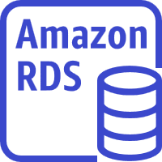
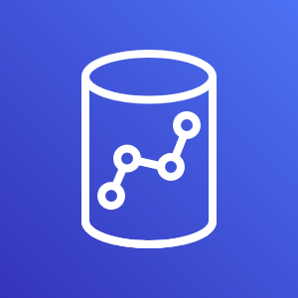
VPC sharing
AWS Cloud
Region
VPC: Account A (owner)
Private subnet
Router
Public subnet
Account D (participant)
Account B (participant)
Account C (participant)
NAT gateway
Internet gateway
EC2 instance
EC2 instance
EC2 instance
RDS instance
Amazon Redshift
EC2 instance
Notes:
VPC sharing enables customers to share subnets with other AWS accounts in the same organization in AWS Organizations. VPC sharing enables multiple AWS accounts to create their application resources—such as Amazon EC2 instances, Amazon Relational Database Service (Amazon RDS) databases, Amazon Redshift clusters, and AWS Lambda functions—into shared, centrally managed VPCs. In this model, the account that owns the VPC (owner) shares one or more subnets with other accounts (participants) that belong to the same organization in AWS Organizations. After a subnet is shared, the participants can view, create, modify, and delete their application resources in the subnets that are shared with them. Participants cannot view, modify, or delete resources that belong to other participants or the VPC owner.
VPC sharing offers several benefits:
Separation of duties – Centrally controlled VPC structure, routing, IP address allocation
Ownership – Application owners continue to own resources, accounts, and security groups
Security groups – VPC sharing participants can reference the security group IDs of each other
Efficiencies – Higher density in subnets, efficient use of VPNs and AWS Direct Connect
No hard limits – Hard limits can be avoided—for example, 50 virtual interfaces per AWS Direct Connect connection through simplified network architecture
Optimized costs – Costs can be optimized through the reuse of NAT gateways, VPC interface endpoints, and intra-Availability Zone traffic
VPC sharing enables you to decouple accounts and networks. You have fewer, larger, centrally managed VPCs. Highly interconnected applications automatically benefit from this approach.
https://docs.aws.amazon.com/vpc/latest/userguide/vpc-sharing.html

Slide 33
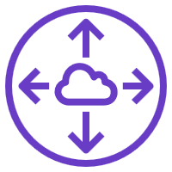
VPC peering
AWS Cloud
You can connect VPCs in your own AWS account, between AWS accounts, or between AWS Regions.
Restrictions:
IP spaces cannot overlap.
Transitive peering is not supported.
You can only have one peering resource between the same two VPCs.
VPC A: 10.0.0.0/16
VPC B: 10.3.0.0/16
Peering connection (pcx-id)
Route Table for VPC A
Route Table for VPC B
Destination | Target
10.0.0.0/16 | local
10.3.0.0/16 | pcx-id
Destination | Target
10.3.0.0/16 | local
10.0.0.0/16 | pcx-id
Notes:
A VPC peering connection is a networking connection between two VPCs that enables you to route traffic between them privately. Instances in either VPC can communicate with each other as if they are within the same network. You can create a VPC peering connection between your own VPCs, with a VPC in another AWS account, or with a VPC in a different AWS Region.
When you set up the peering connection, you create rules in your route table to allow the VPCs to communicate with each other through the peering resource. For example, suppose that you have two VPCs. In the route table for VPC A, you set the destination to be the IP address of VPC B and the target to be the peering resource ID. In the route table for VPC B, you set the destination to be the IP address of VPC A and the target to be the peering resource ID.
VPC peering has some restrictions:
IP address ranges cannot overlap.
Transitive peering is not supported. For example, suppose that you have three VPCs: A, B, and C. VPC A is connected to VPC B, and VPC A is connected to VPC C. However, VPC B is not connected to VPC C implicitly. To connect VPC B to VPC C, you must explicitly establish that connectivity.
You can only have one peering resource between the same two VPCs.
For more information about VPC peering, see VPC Peering in the AWS Documentation.
https://docs.aws.amazon.com/vpc/latest/peering/vpc-peering-basics.html
Diff between VPC Sharing and Peering
VPC Peering is basically a networking process. In old school it is like telling your networking team to create connections and routes between data centres.
VPC sharing is more a permissions process. Allowing two or more corporate divisions to have service in the same VPC.

Slide 34
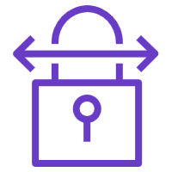
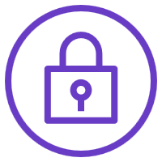
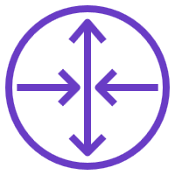

AWS Site-to-Site VPN
AWS Cloud
Public subnet route table
Region
Destination | Target
10.0.0.0/16 | local
0.0.0.0/0 | igw-id
Availability Zone
VPC: 10.0.0.0/16
Site-to-Site VPN connection
Public subnet:10.1.0.0/24
Private subnet route table
Internet
Destination | Target
10.0.0.0/16 | local
192.168.10.0/24 | vgw-id
Private subnet: 10.0.2.0/24
Route table
Virtual gateway (vgw-id)
Customer gateway
Corporate data center: 192.168.10.0/24
Notes:
AWS Site-to-Site VPN is a fully-managed service that creates a secure connection between your data center or branch office and your AWS resources using IP Security (IPSec) tunnels. For globally distributed applications, the Accelerated Site-to-Site VPN option provides even greater performance by working with AWS Global Accelerator to intelligently route your traffic to the nearest AWS network endpoint with the best performance.
By default, instances that you launch into a VPC cannot communicate with a remote network. To connect your VPC to your remote network (that is, create a virtual private network or VPN connection), you:
Create a new virtual gateway device (called a virtual private network (VPN) gateway) and attach it to your VPC.
Define the configuration of the VPN device or the customer gateway. The customer gateway is not a device but an AWS resource that provides information to AWS about your VPN device.
Create a custom route table to point corporate data center-bound traffic to the VPN gateway. You also must update security group rules. (You will learn about security groups in the next section.)
Establish an AWS Site-to-Site VPN (Site-to-Site VPN) connection to link the two systems together.
Configure routing to pass traffic through the connection.
For more information about AWS Site-to-Site VPN and other VPN connectivity options, see VPN Connections in the AWS Documentation.
https://aws.amazon.com/vpn/site-to-site-vpn/

Slide 35
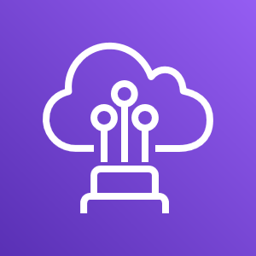
AWS Direct Connect
AWS Cloud
Region
Availability Zone
Internet
VPC: 10.0.0.0/16
Public subnet:10.1.0.0/24
802.1q VLAN
AWS Direct Connect
Private subnet: 10.0.2.0/24
Route table
Virtual gateway
Customer gateway
Corporate data center: 192.168.10.0/24
Notes:
The AWS Direct Connect cloud service is the shortest path to your AWS resources. While in transit, your network traffic remains on the AWS global network and never touches the public internet. This reduces the chance of hitting bottlenecks or unexpected increases in latency. When creating a new connection, you can choose a hosted connection provided by an AWS Direct Connect Delivery Partner, or choose a dedicated connection from AWS—and deploy at over 100 AWS Direct Connect Locations around the globe. With AWS Direct Connect SiteLink, you can send data between AWS Direct Connect locations to create private network connections between the offices and data centers in your global network.
One of the challenges of network communication is network performance. Performance can be negatively affected if your data center is located far away from
your AWS Region. For such situations, AWS offers AWS Direct Connect, or DX. AWS Direct Connect enables you to establish a dedicated, private network connection between your network and one of the DX locations. This private connection can reduce your network costs, increase bandwidth throughput, and provide a more consistent network experience than internet-based connections. DX uses open standard 802.1q virtual local area networks (VLANs).
For more information about DX, see the AWS Direct Connect product page.
https://aws.amazon.com/directconnect/

Slide 36
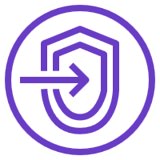

VPC endpoints
AWS Cloud
Default DNS hostname or endpoint-specific DNS hostname
Public Subnet Route Table
Destination | Target
10.0.0.0/16 | local
Amazon S3 ID | vpcep-id
Region
Availability Zone
VPC: 10.0.0.0/16
Public subnet:10.0.1.0/24
Two types of endpoints:
Interface endpoints (powered by AWS PrivateLink)
Gateway endpoints (Amazon S3 and Amazon DynamoDB)
VPC endpoint
(vpcep-id)
Amazon Simple Storage Service (Amazon S3)
Private subnet: 10.0.2.0/24
Elastic Network Interface
Notes:
A VPC endpoint is a virtual device that enables you to privately connect your VPC to supported AWS services and VPC endpoint services that are powered by AWS PrivateLink. Connection to these services does not require an internet gateway, NAT device, VPN connection, or AWS Direct Connect connection. Instances in your VPC do not require public IP addresses to communicate with resources in the service. Traffic between your VPC and the other service does not leave the Amazon network.
There are two types of VPC endpoints:
An interface VPC endpoint (interface endpoint) enables you to connect to services that are powered by AWS PrivateLink. These services include some AWS services, services that are hosted by other AWS customers and AWS Partner Network (APN) Partners in their own VPCs (referred to as endpoint services), and supported AWS Marketplace APN Partner services. The owner of the service is the service provider, and you—as the principal who creates the interface endpoint—are the service consumer. You are charged for creating and using an interface endpoint to a service. Hourly usage rates and data processing rates apply. See the AWS Documentation for a list of supported interface endpoints and for more information about the example shown here.
Gateway endpoints: The use of gateway endpoints incurs no additional charge. Standard charges for data transfer and resource usage apply.
For more information about VPC endpoints, see VPC Endpoints in the AWS Documentation.
https://docs.aws.amazon.com/vpc/latest/privatelink/vpc-endpoints.html

Slide 37
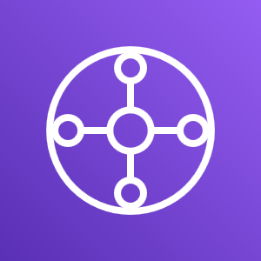
AWS Transit Gateway
From this…
To this…
Customer gateway
VPN connection
Amazon VPC
VPC peering
Amazon VPC
AWS Direct Connect gateway
Amazon VPC
Amazon VPC
VPN connection
VPC peering
VPC peering
VPC peering
AWS Direct Connect gateway
AWS Transit Gateway
VPN connection
Amazon VPC
Amazon VPC
Amazon VPC
VPC peering
Amazon VPC
VPN connection
Notes:
AWS Transit Gateway connects VPCs and on-premises networks through a central hub. This simplifies your network and puts an end to complex peering relationships. It acts as a cloud router – each new connection is only made once.
You can configure your VPCs in several ways, and take advantage of numerous connectivity options and gateways. These options and gateways include AWS Direct Connect (via DX gateways), NAT gateways, internet gateways, VPC peering, etc. It is not uncommon to find AWS customers with hundreds of VPCs distributed across AWS accounts and Regions to serve multiple lines of business, teams, projects, and so forth. Things get more complex when customers start to set up connectivity between their VPCs. All the connectivity options are strictly point-to-point, so the number of VPC-to-VPC connections can grow quickly. As you grow the number of workloads that run on AWS, you must be able to scale your networks across multiple accounts and VPCs to keep up with the growth.
Though you can use VPC peering to connect pairs of VPCs, managing point-to-point connectivity across many VPCs without the ability to centrally manage the connectivity policies can be operationally costly and difficult. For on-premises connectivity, you must attach your VPN to each individual VPC. This solution can be time-consuming to build and difficult to manage when the number of VPCs grows into the hundreds.
To solve this problem, you can use AWS Transit Gateway to simplify your networking model. With AWS Transit Gateway, you only need to create and manage a single connection from the central gateway into each VPC, on-premises data center, or remote office across your network. A transit gateway acts as a hub that controls how traffic is routed among all the connected networks, which act like spokes. This hub-and-spoke model significantly simplifies management and reduces operational costs because each network only needs to connect to the transit gateway and not to every other network. Any new VPC is connected to the transit gateway, and is then automatically available to every other network that is connected to the transit gateway. This ease of connectivity makes it easier to scale your network as you grow.
https://aws.amazon.com/transit-gateway/

Slide 38
Activity: Label this network diagram
AWS Cloud
?
?
?
Public subnet:10.0.1.0/24
?
?
Internet
?
_?_ IP address
Q6
?
Destination | Target
? | local
0.0.0.0/0 | ?
Private subnet: 10.0.2.0/24
?
?
?
_?_ IP address
10.0.0.0/16
Notes:
See if you can recognize the different VPC networking components that you learned about by labeling this network diagram.

Slide 39
Activity: Solution
AWS Cloud
Region
Availability Zone
VPC
Public subnet:10.0.1.0/24
Public subnet
Internet gateway
Route table
Internet
Private IP address
NAT gateway
Route
Destination | Target
10.0.0.0/16 | local
0.0.0.0/0 | igw-id
Private subnet
Private subnet: 10.0.2.0/24
Route table
Elastic network interface
Private IP address
10.0.0.0/16
Notes:
Now, see how well you did.

Slide 40
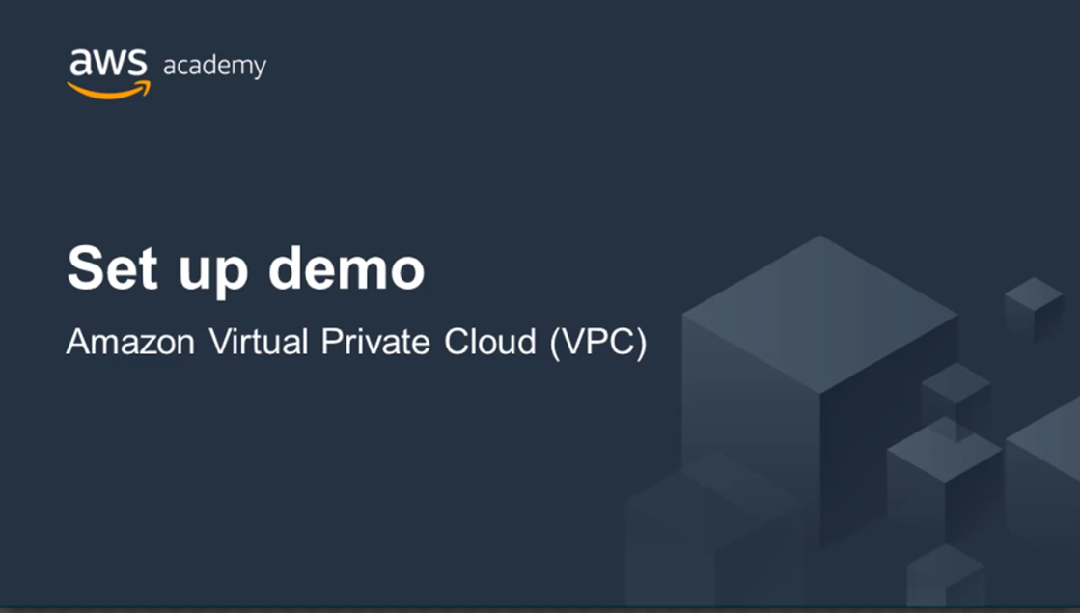
Recorded Amazon VPC demonstration
Notes:
Now that you know how to design a VPC, watch this demonstration to learn how to use the VPC Wizard to set up a VPC with public and private subnets.

Slide 41
Section 3 key takeaways
There are several VPC networking options, which include:
Internet gateway
NAT gateway
VPC endpoint
VPC peering
VPC sharing
AWS Site-to-Site VPN
AWS Direct Connect
AWS Transit Gateway
You can use the VPC Wizard to implement your design.
Notes:
Some key takeaways from this section of the module include:
There are several VPC networking options, which include:
Internet gateway: Connects your VPC to the internet
NAT gateway: Enables instances in a private subnet to connect to the internet
VPC endpoint: Connects your VPC to supported AWS services
VPC peering: Connects your VPC to other VPCs
VPC sharing: Allows multiple AWS accounts to create their application resources into shared, centrally-managed Amazon VPCs
AWS Site-to-Site VPN: Connects your VPC to remote networks
AWS Direct Connect: Connects your VPC to a remote network by using a dedicated network connection
AWS Transit Gateway: A hub-and-spoke connection alternative to VPC peering
You can use the VPC Wizard to implement your design.

